Slide 1
CSE 4101
Lecture 8
Topic: Frame Structures, Associative Networks

Slide 2
Introduction
A frame is a record like structure which consists of a collection of attributes and its values to describe an entity in the world. Frames are the AI data structure which divides knowledge into substructures by representing a mental (psychological) of a stereotypical situation such as driving a car, attending a meeting, or eating in a restaurant stereotypes situations.

Slide 3
Stereotype
A ‘stereotype ; is a mental representation and a form of social categorization made about specific individuals or a group and its members.
Gender, race political stance (stand) and personality contribute to the stereotype which we place on others, but they are generally based on race and gender.
A stereotype is an over-simplified and unjustified opinion about others.

Slide 4
Stereotype
It is problematic because it ignores diversity among individuals.
Stereotypes are intentional because images are created and fixed on people.
It forcibly associates a pattern or type onto a large number of people.

Slide 5
Stereotype
It is problematic because it ignores diversity among individuals.
Some of the examples of stereotype (based on gender) are:
  Girls are emotional, soft spoken.
  Girls are good at dance, cooking and painting.
  Girls are emotional.
  Boys are naughty.
  Boys are good at sport.

Slide 6
Frame Structure
It consists of a collection of slots and slot values. These slots may be of any type and sizes. Slots have names and values which are called facets. They were proposed by Marvin Minsky in his 1974 article "A Framework for Representing Knowledge".

Slide 7
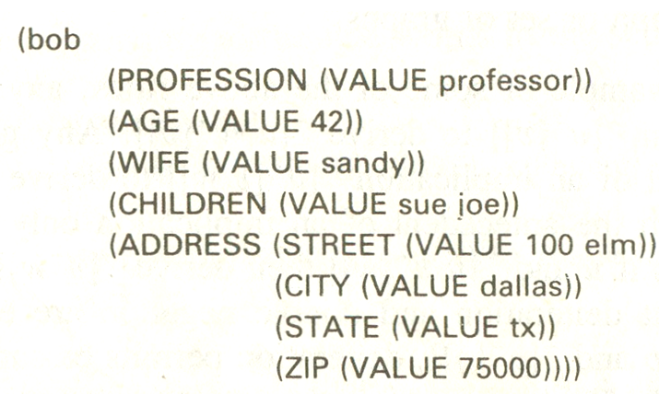
Example 1
Name of the frame “bob”
From left side , VALUE, ZIP, ADRRESS, bob

Slide 8
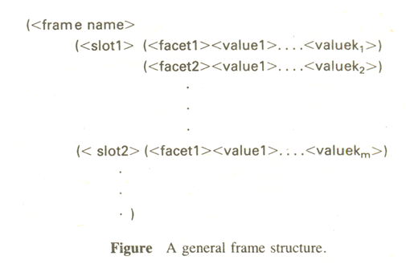
Frame Template Structure

Slide 9
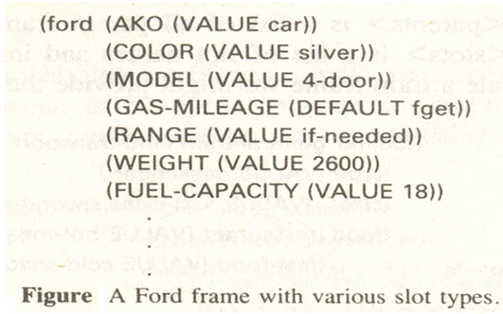
Example 2
Name of the frame “ford”

Slide 10
Associative Networks
Associative networks were introduced by Quillian (1968) to model the semantics of English sentences and words. He called this structures semantic networks to signify their intended use.
Associative networks are directed graphs with labeled nodes and arcs or arrows.

Slide 11
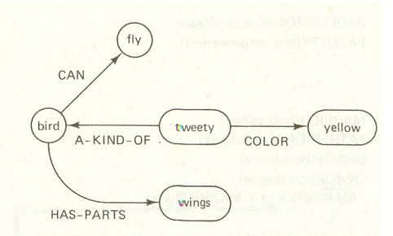
Associative Networks
In this figure, a class of objects known as Bird is depicted. The class has some properties and a specific member of the class named Tweety is shown. The color of Tweety is seen to be yellow.

Slide 12
Syntax and Semantics of Associative Networks
Basically, the language of associative networks is formed from letters of the alphabet, both upper and lowercase, relational symbols, set membership (The symbol ∈ indicates set membership and means “is an element of” so that the statement x∈A means that x is an element of the set A) and subset symbols (⊆) (A set A is a subset of another set B if all or some elements of the set A are elements of the set B) , decimal digits and oval nodes, and directed arcs of arbitrary length.

Slide 13
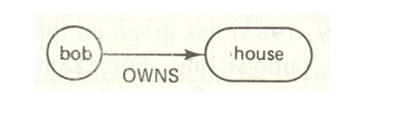
Syntax and Semantics of Associative Networks
Nodes are commonly used for objects or nouns, and arcs (or arcs nodes) for relations. The direction of an arc is usually taken from the first to subsequent arguments as they appear in a relational statement. Thus, OWNS (bob, house) would be written as,

Slide 14
Syntax and Semantics of Associative Networks
A number of arc relations have become common among users. They include such predicates as ISA, MEMBER-OF, SUBSET-OF, AKO (a kind-Of), HAS-PARTS, INSTANCES-OF, AGENT, ATTRIBUTES, SHAPED-LIKE and so forth.

Slide 15
ISA link
One particular arc or link, the ISA (is a) link, has taken on a special meaning.
It signifies that Bob is a professor and that the state university system is an institute of higher learning.
ISA relationships occur in many representations of words: Bill is a student; a cat is a furry animal, a tree is a plant, and so on.

Slide 16
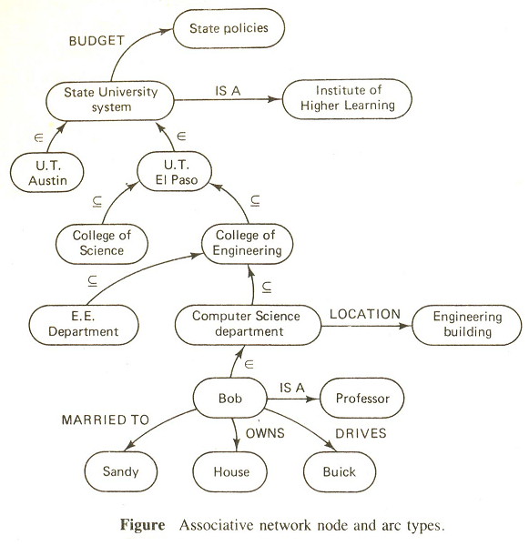
ISA link

Slide 17
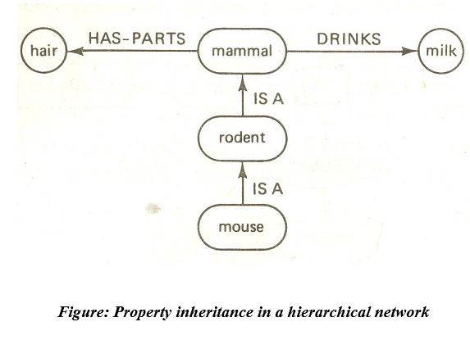
Property Inheritance
Associative network structures permit the implementation of property inheritance, Nodes which are members or subsets of other nodes may inherit properties from their higher-level ancestor nodes. For example, the network from the following figure, it is possible to infer that a mouse has hair and drinks milk.

Slide 18
End

